Slide 1
Responsive enterprise mobile development
Day 2

Slide 2
recap
Notes:
We assigned 10 minutes to this topic.

Slide 3
REcap
Class Overview
Architecture
WebStorm, Xcode and AppCode
C# => Objective-C
Cross-Platform Hybrid Hello World
Getting from C# MV* to Objective-C
Version Control

Slide 4
On the dance card for today
iOS Developer Certs / Provisioning
Javascript 101 and Prototypes
jQuery and some Alternatives
Templates – EJS, Handlebars, Mustache
Backbone and Underscore Fundamentals
C# MV* to Backbone MV*
RequireJS
Debugging/Styling with Safari & Chrome Web Inspectors
Debugging Javascript in the Simulator or on the Device
LAB: Build Scavhn’s Home Screen View (up to the metal. Styling tomorrow)

Slide 5
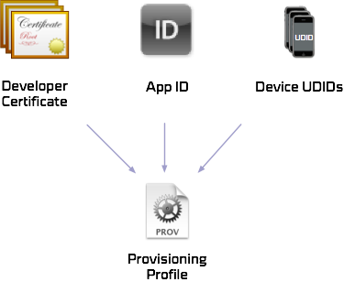
Mobile device management
Notes:
We assigned 30 minutes to this topic.

Slide 6
Lab: Mobile device management
In this lab, you will set up a Developer Cert and Provisioning Profile so you can deploy the Hello World app that you created in the previous lab.
Notes:
Lab purpose slide

Slide 7
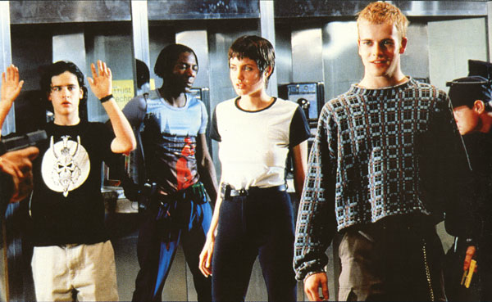

JavaScript 101
Notes:
We assigned 30 minutes to this topic.

Slide 8
JavaScript 101
Still a scripting language
You can do this:
var hello = “world”
then this:
hello = 1;
Has NOTHING to do with Java
Written in ‘95 by Brendan Eich @ Netscape
Notes:
Scripting language, not a structural language
Jump out to script tag example in markup

Slide 9
JavaScript 101
Prototype-based programming
A style of object-oriented programming in which behavior reuse (known as inheritance) is performed via a process of cloning existing objects that serve as prototypes.
Notes:
Scripting language, not a structural language
Jump out to script tag example in markup

Slide 10
JavaScript 101
Prototype-based programming
var foo = {name: "foo", one: 1, two: 2};
var bar = {two: "two", three: 3};
bar.__proto__ = foo;
bar.one // Resolves to 1.
bar.three // Resolves to 3.
bar.two // STILL resolves to 2.
bar.__proto__.two // Resolves to “two”.
Notes:
Scripting language, not a structural language
Jump out to script tag example in markup
Find prototype thing you did in DAS
IF you get the two collision question:
bar.two will be “two” – “two” wins. There is no name collision. Proto appends foo to the end, so there is foo’s .two and bar’s .two
To get to foo’s .two after bar.__proto__ = foo;
Do
bar.__proto__.foo.two will be “2”
EX NIHILO – “out of nothing”
1. // "ex nihilo" object creation using the literal
// object notation {}.
2. // Another "ex nihilo" object.
3. // Gecko and Webkit JavaScript engines can directly
// manipulate the internal prototype link.
// For the sake of simplicity, let us pretend
// that the following line works regardless of the
// engine used:

Slide 11

jQuery
$. + $.() = $$$
Notes:
We assigned 40 minutes to this topic.

Slide 12
jQuery
It’s simple.
The DOM is the database, XML doc…
The $ is the SQL, the Xpath
Uses CSS Selectors to filter to the “fields” you want to “SELECT”
When you find what you seek, you apply some magic – DOM/CSS manipulation, animation, etc.
Notes:
Created by John Resig, who introduced it to the world at BarCamp (an open space dev conference) in 2006. Snot nosed kid who was working at Mozilla at the time, probably not more than 21, 22.
Talk about CSS Selectors & IDs, types

Slide 13
jQuery
It’s $.AJAX.
It’s UI.
It’s mobile.
Notes:
Talk about service calls on this one. Jump out to an example.
http://jqueryui.com/
http://jquerymobile.com/

Slide 14
Jquery resources and examples
Start here:
http://learn.jquery.com/using-jquery-core/

Slide 15
Jquery resources and examples
To find
<div class=“hello”>content</div>
Do
$(‘.hello’)
To find
<div id=“hello”>content</div>
Do
$(‘#hello’)
Notes:
Jump out here to examples.

Slide 16
Jquery with css3 selectors
To find any div elements with “highlighted” in the CSS class name
<div class=“hello-one-highlighted”>
content
</div>
<div class=“hello-two-highlighted”>
content
</div>
Do
$('div[class$=\'highlighted\']')
Is sorta like
SELECT div FROM index.html WHERE class LIKE ‘*highlighted’
And
$('div[class*=\'highlighted\']')
Is sorta like
SELECT div FROM index.html WHERE class LIKE ‘*highlighted*’
Notes:
Jump out here to examples.

Slide 17
Jquery with css3 selectors
To find the first list element in an unordered list
<ul>
<li>content1</li>
<li>content2</li>
</ul>
Do
$('ul li:first-of-type')
Is sorta like
SELECT TOP 1 ul li (list element in any unordered list) FROM index.html
Notes:
Jump out here to examples.

Slide 18
Jquery Alternatives
jQuery payload too big and bloated? Roll your own distro:
http://net.tutsplus.com/tutorials/javascript-ajax/how-to-build-your-own-custom-jquery/
ZeptoJS: http://zeptojs.com/
NOT jQuery, but jQuery-like
Mature, big community support, well maintained
9.7k minified, configurable to be even smaller
Touch/swipe support
Notes:
Jump out here to examples.

Slide 19
Jquery Alternatives
MinifiedJS: http://minifiedjs.com/
Weighs in at 4k (IE support disabled)
Matches ZeptoJS features set, except for array helpers, touch/swipe
Notes:
Jump out here to examples.

Slide 20
EJS templates
<% … %>
<%= … %>
Notes:
We assigned 10 minutes to talking about this topic.

Slide 21
Ejs templates
EJS == Embedded JavaScript
Think ASP.NET server tags.
http://embeddedjs.com
One template engine among many:
Mustache (similar to Angular templates)
Handlebars
Notes:
Talk about how it comes with backbone out of the box.

Slide 22

backbone and underscore fundamentals

Slide 23
Backbone and underscore fundamentals
Backbone: An MV* framework for JS
Underscore: Helper extensions for JS. A hard dependency for Backbone.
Notes:
The most malleable of the three to be covered. Will talk more about that later.

Slide 24
Backbone and underscore fundamentals
Backbone Models
Backbone Views
Backbone Routers
Notes:
The most malleable of the three to be covered. Will talk more about that later.

Slide 25
Backbone and underscore fundamentals
Underscore
A library of helpful javascript extensions
Primarily for working with arrays and dictionaries of data
Think LINQ for JS. Allows you to filter, combine and add data in a similar manner
Notes:
Jump out to show examples in Scavhn

Slide 26
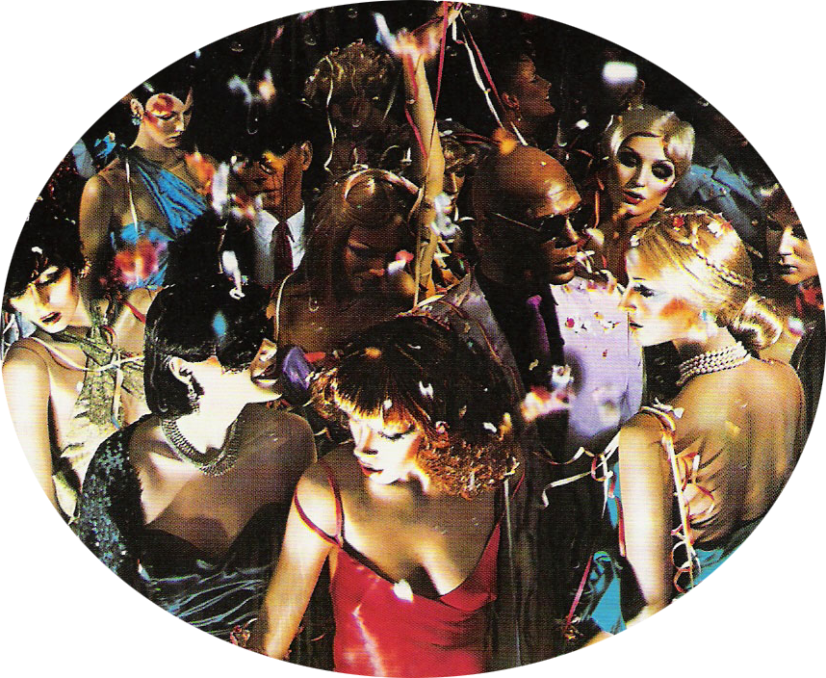

Getting from C# mv* to JavaScript
Notes:
We assigned 70 minutes to this topic.

Slide 27
C# MV* => JavaScript
Javascript == MV*
BackboneJS
AngularJS
KnockoutJS
Addy Osmani is your friend.
http://addyosmani.com/blog/
Notes:
Breakout here to show some examples

Slide 28

RequireJS
Notes:
We assigned 20 minutes to talking about this topic.

Slide 29
RequireJS
An asynchronous javascript module loader
Supports the ability to dynamically load and unload chunks of javascript
Which, in turn, supports class-like encapsulation

Slide 30
RequireJS
Very, very, very deep. Can do many things.
Let’s look at how it works.

Slide 31
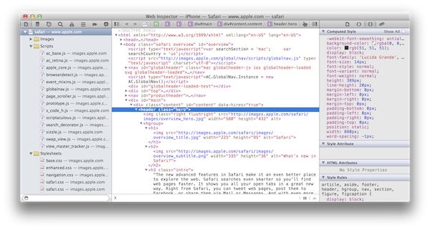
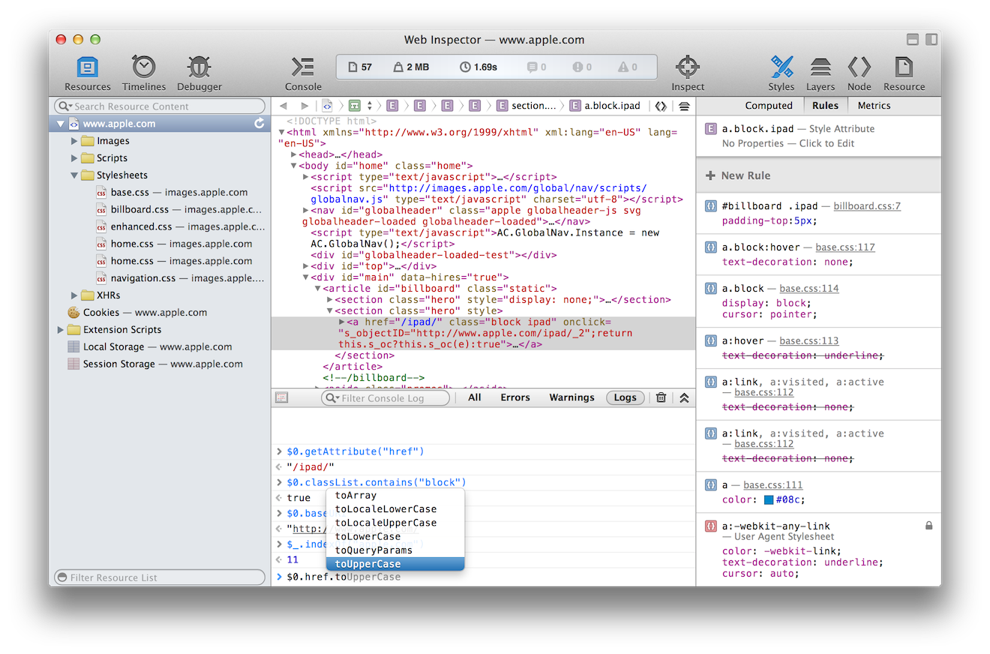
Chrome and Safari web inspectors
Notes:
We assigned 30 minutes to talking about this topic.
Talk about the responsive web extension for Safari, have folks install it, show it to them.

Slide 32
Chrome and Safari web inspectors
Your go-to tools for debugging and ad-hoc style work
Javascript object inspection, Console instrumentation on inspection
Javascript profiling
Powerful Live CSS manipulation
Notes:
Bust out at this point to show some things it can do

Slide 33
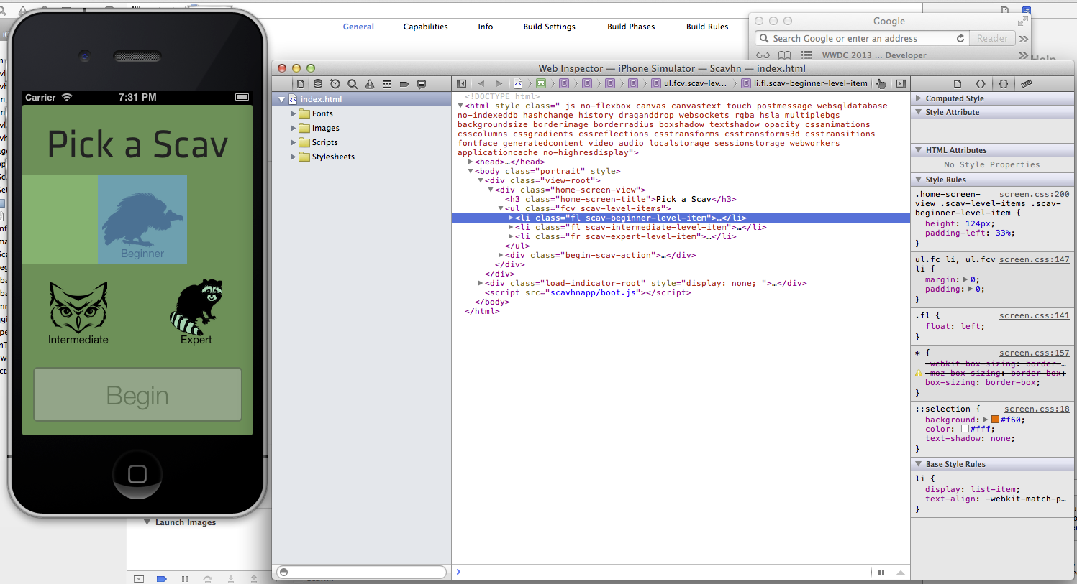
Debugging JavaScript in the simulator
Notes:
We assigned 30 minutes to talking about this topic.

Slide 34
Debugging JS in the Simulator
Let’s Dive in

Slide 35
Getting from C# To Javascript
{ } == ({ })()
Notes:
We assigned 70 minutes to this topic. Figure 35-40 min for this, then cover javascript

Slide 36
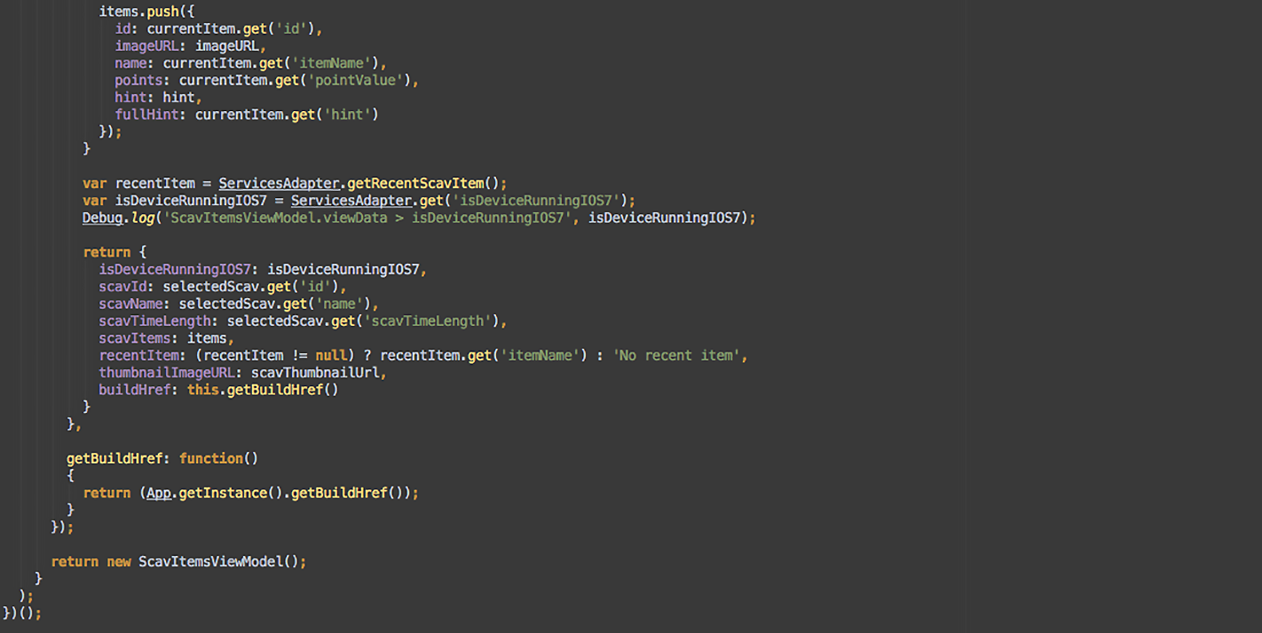
Javascript examples
Notes:
Crack open VS2012 and AppCode to show some stuff off

Slide 37

Lab: the big lab
Notes:
We assigned 4 hours to doing this.

Slide 38
Lab: The big lab
In this lab, you will create the landing view in the Scavhn hybrid app using Backbone.js, Underscore.js, EJS templates, and RequireJS.
Good thing you have 4 hours for this.
Notes:
POST DIAGRAM NOW

Slide 39
the big lab will be focusing on:
HTML / CSS
HTML5
SASS / COMPASS
LIVE EDIT
JAVASCRIPT
JASMINE
REQUIREJS
SINONJS
BACKBONE / UNDERSCORE
JQUERY
KARMA
PHANTOMJS
iOS - OBJECTIVE-C
UIWEBVIEW
OBJ-C MOCKS
AFNETWORKING
XCTEST
CORE DATA
TYPHOON

Slide 40


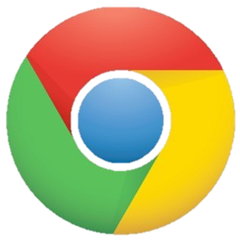
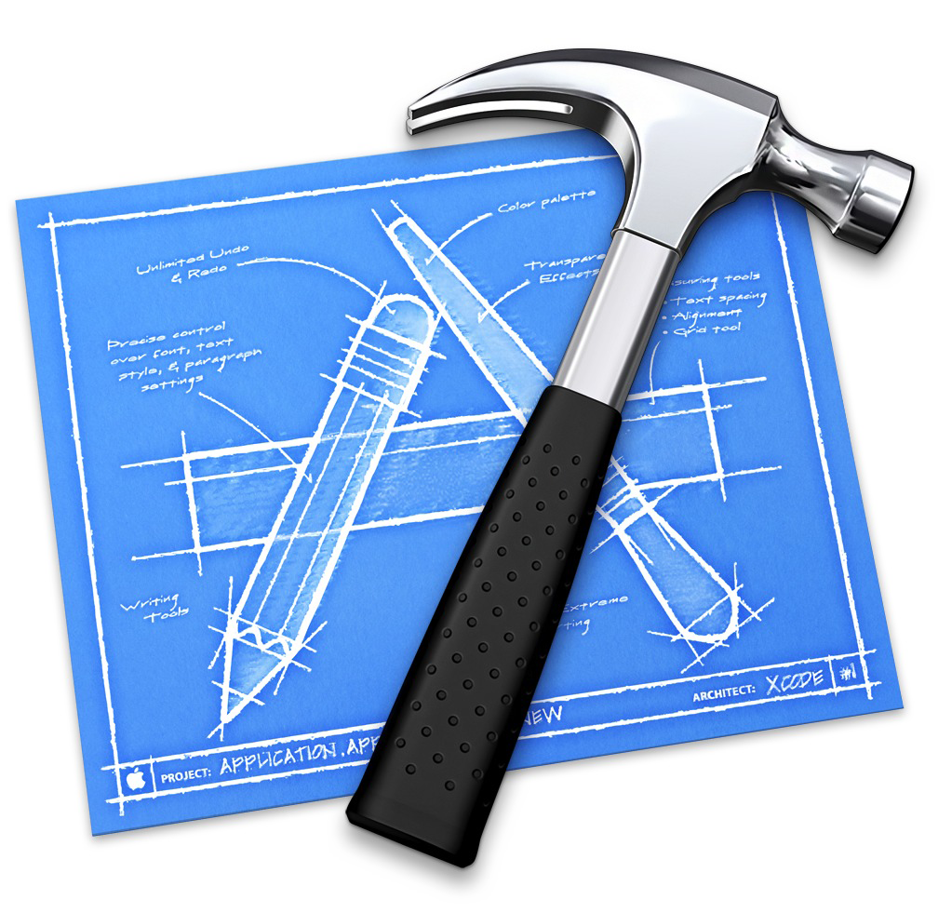

Tools we’ll be using
HTML / CSS
Safari
JetBrains WebStorm
Chrome
JAVASCRIPT
Safari
JetBrains WebStorm
Chrome
iOS - OBJECTIVE-C
Xcode 5
JetBrains AppCode

Slide 41
That’s enough for today.
We start again tomorrow at 8:30.

